Slide 1
CAS AML 2022 Reinforcement Learning
Introduction
Dr. Lorenzo Brigato
Artificial Intelligence in Health and Nutrition (AIHN) Laboratory ARTORG Center for Biomedical Engineering Research University of Bern

Slide 2
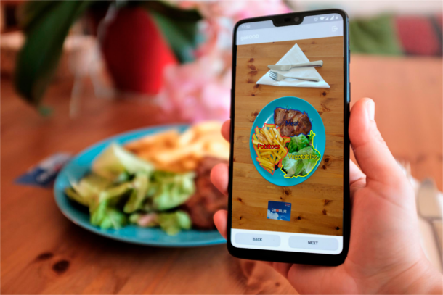
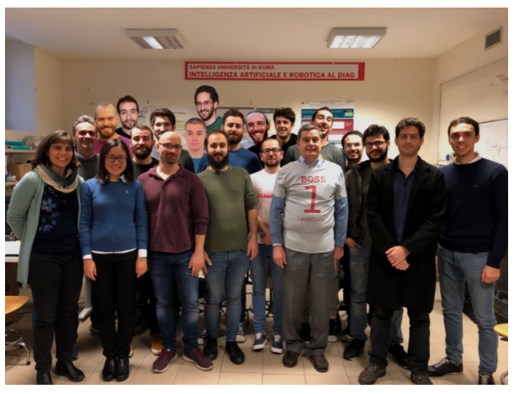
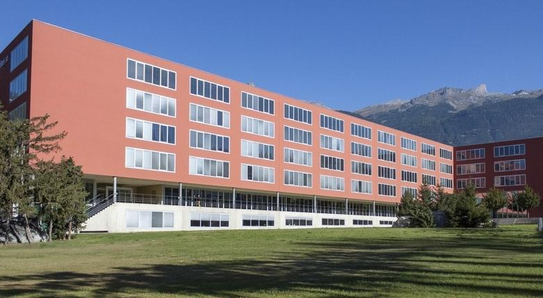
Short Introduction
Postdoctoral researcher (currently)
Member of the AIHN laboratory @ ARTORG center, University of Bern
Involved in the MELISSA European project
Computer vision for extracting nutrient contents
Time-series analysis to predict blood-glucose trends
Reinforcement learning agent to control insulin injections
Ph.D. candidate (2018-2022)
Member of Ro.Co.Co. laboratory @ Sapienza University of Rome (Italy)
Ph.D. thesis on machine learning from data/label-deficient data distributions
Worked with external partners (Italian police, security company) on AI and robotics projects
Master’s student (2016-2018)
AI and Robotics M.Sc.
Master’s thesis on ML for robot hand-prostheses (@University of Western Switzerland)
L. Brigato

Slide 3
Organization of the Module
Module is divided into two main parts:
Elementary RL
Advanced RL
Elementary RL:
Familiarize with RL framework
Learn basic concepts and algorithms
Advanced RL:
Extend elementary RL to more complex domains
Get a glimpse of on-going research
One notebook for each part
L. Brigato

Slide 4
Learning Objectives of the Module
By the end of the module, you will be able to:
Understand the different aspects of RL and the different kinds of RL methods
Implement RL systems by using available libraries
Evaluate and select appropriate RL methods for solving the task at hand
L. Brigato

Slide 5
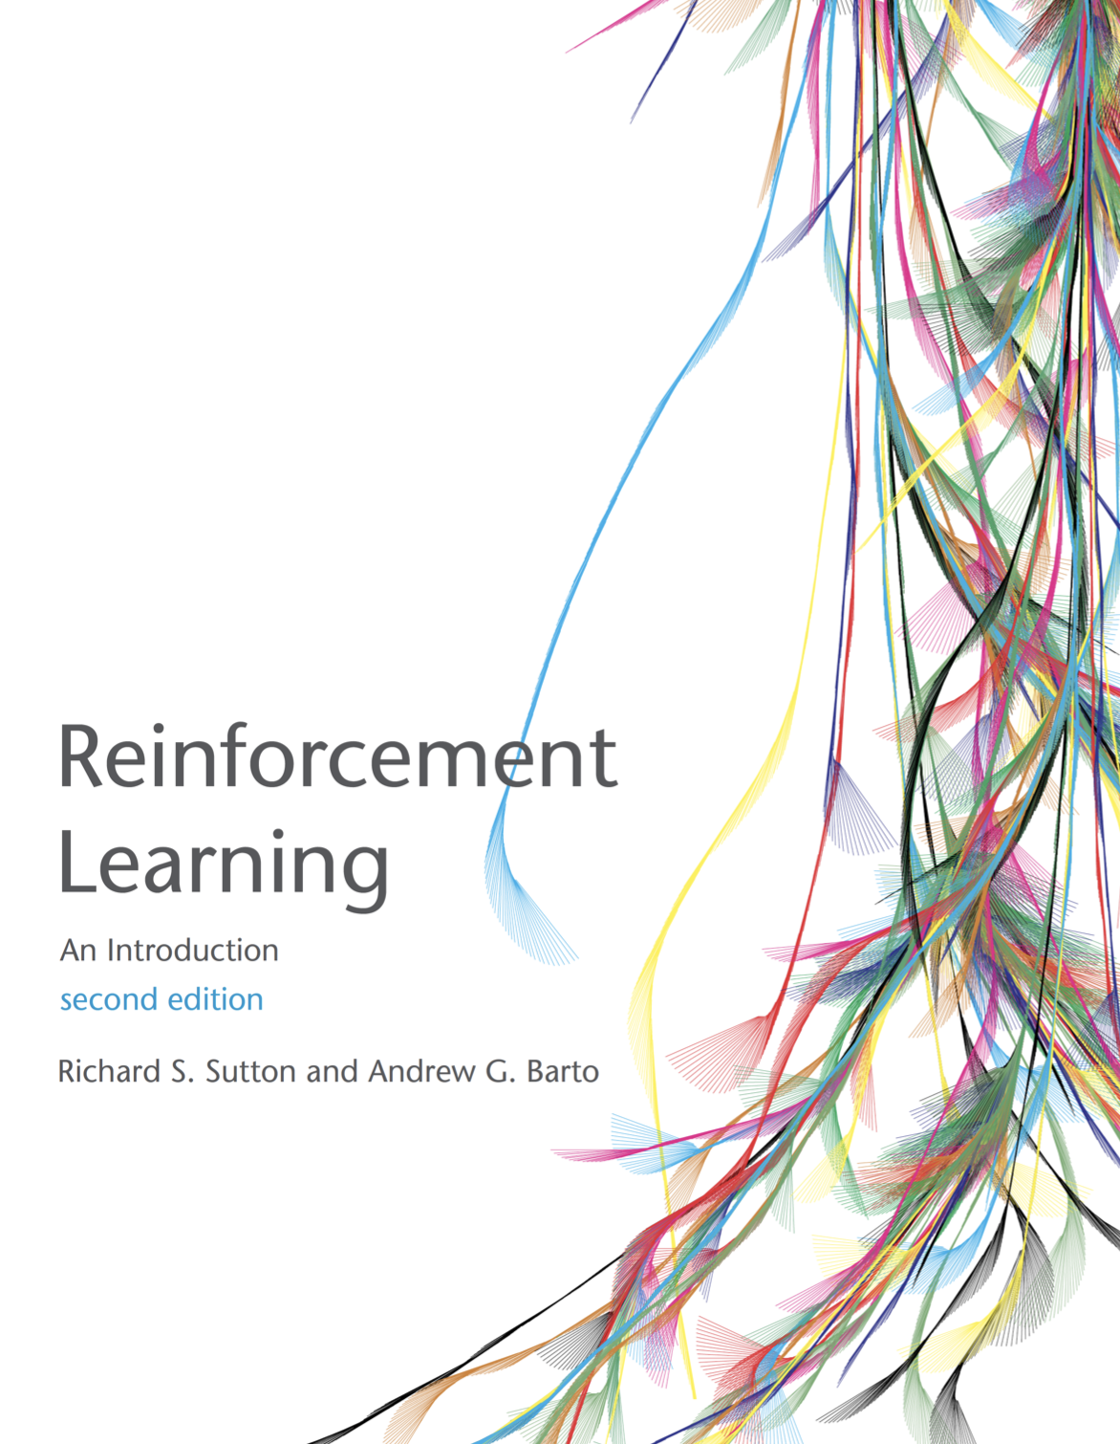
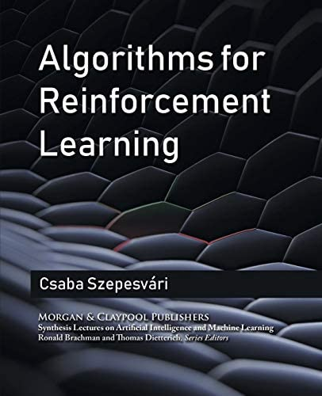
Reading Material
An Introduction to Reinforcement Learning,
Sutton and Barto, MIT Press, 1998
Available free online!
http://webdocs.cs.ualberta.ca/∼sutton/book/the-book.html
Algorithms for Reinforcement Learning,
Csaba Szepesvari, Morgan and Claypool, 2010
Available free online!
http://www.ualberta.ca/∼szepesva/papers/RLAlgsInMDPs.pdf
L. Brigato

Slide 6
Acknowledments
The lecture slides are using parts of the structure and material by:
David Silver (Deep Mind, UCL)
DeepMind Learning Resources (Hado van Hasselt, Diana Borsa & Matteo Hessel), https://www.deepmind.com/learning-resources/reinforcement-learning-lecture-series-2021
L. Brigato

Slide 7
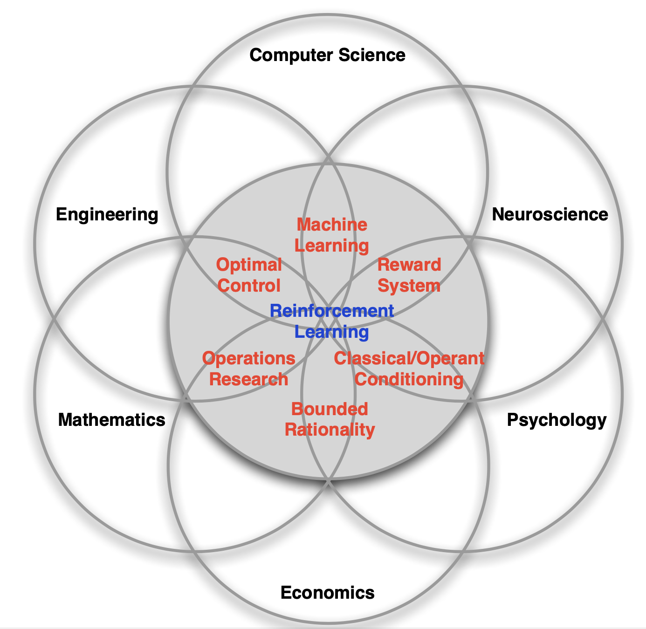
What is Reinforcement Learning?
[David Silver, IRL, UCL 2015]
L. Brigato

Slide 8
What is Reinforcement Learning?
Science and framework of learning to make decisions from interaction
A formalization of the AI problem
People and animals learn by interacting with their environment
This type of learning can be defined as active learning and it based on sequencial interactions
Future interactions depend on earlier ones
The learning is typically goal-oriented
Instead of learning with examples, a reward is optimized
L. Brigato

Slide 9
RL characteristics
There is no direct supervision, only a reward signal
Feedback might be delayed
Time matters (sequential, non i.i.d. data)
Agent’s actions affect the subsequent data it receives
L. Brigato

Slide 10
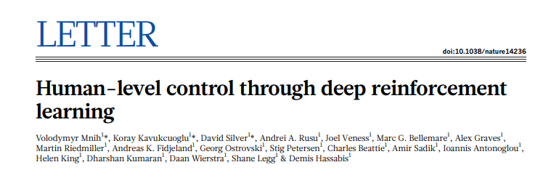
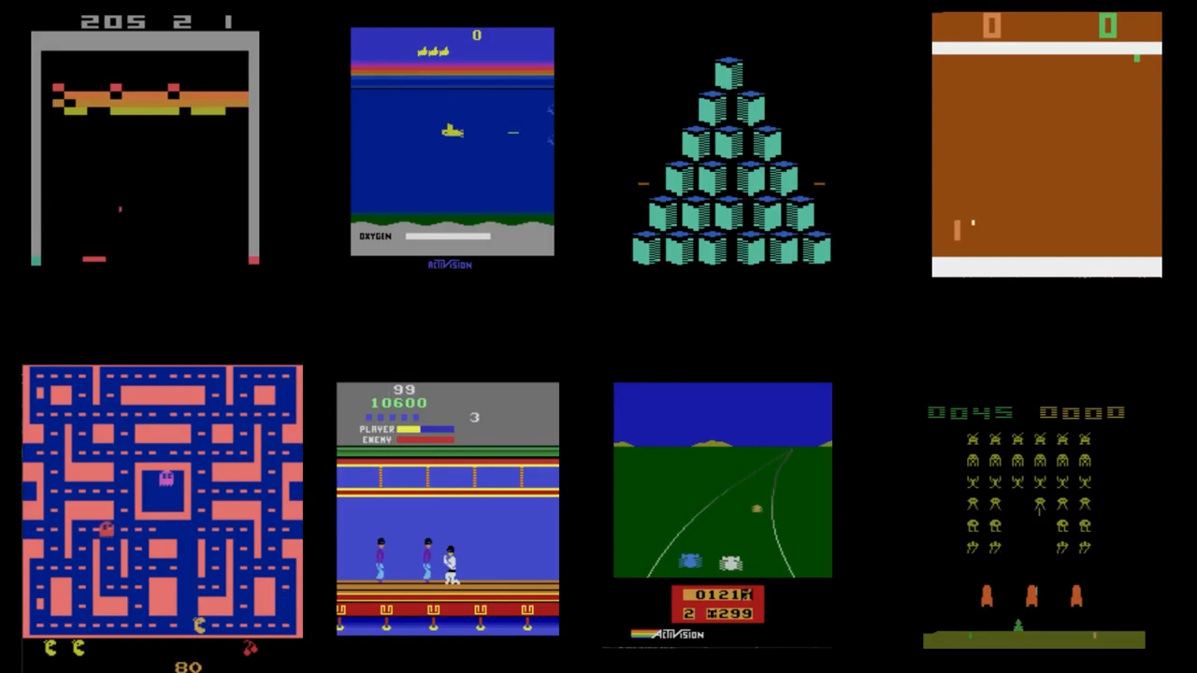
(Some) (Deep) RL Milestones
L. Brigato

Slide 11
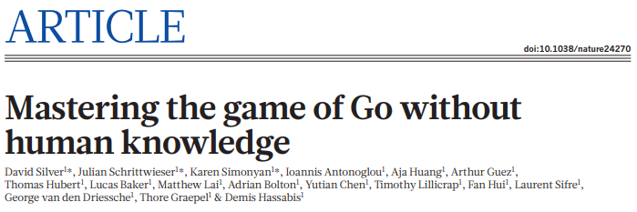
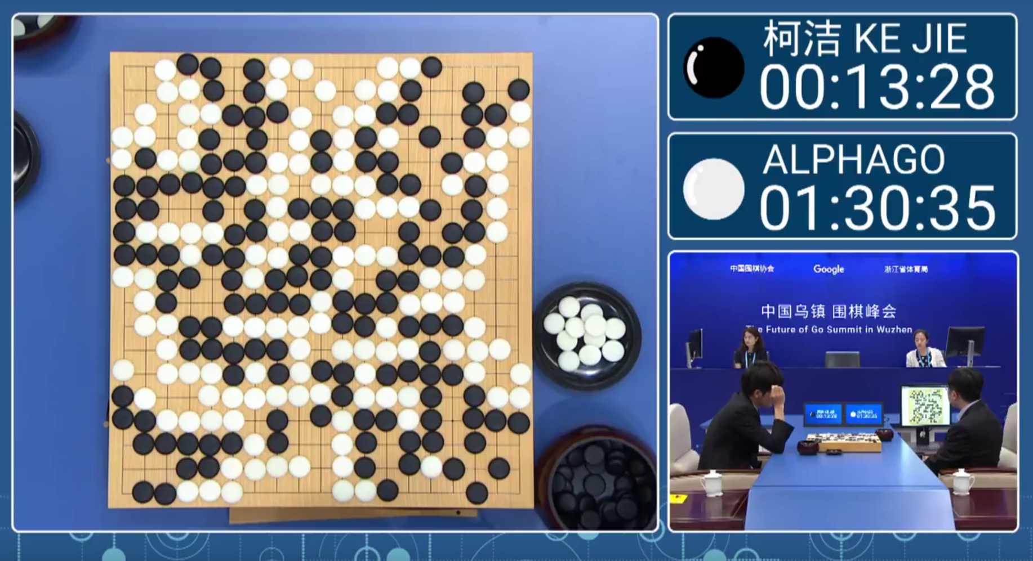
(Some) (Deep) RL Milestones
L. Brigato

Slide 12
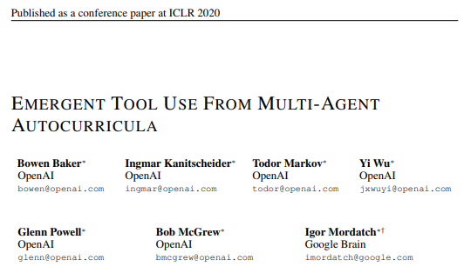
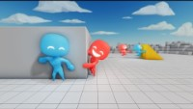
(Some) (Deep) RL Milestones
L. Brigato

Slide 13
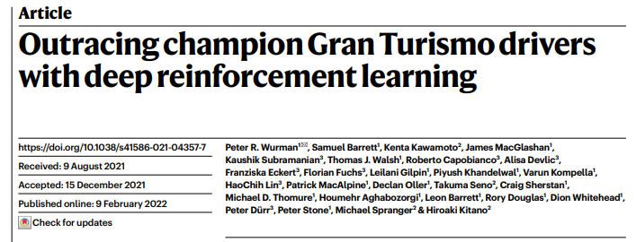
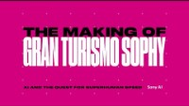
(Some) (Deep) RL Milestones
L. Brigato

Slide 14
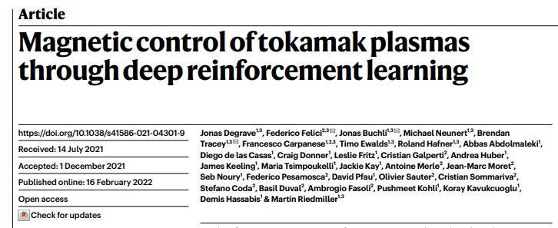
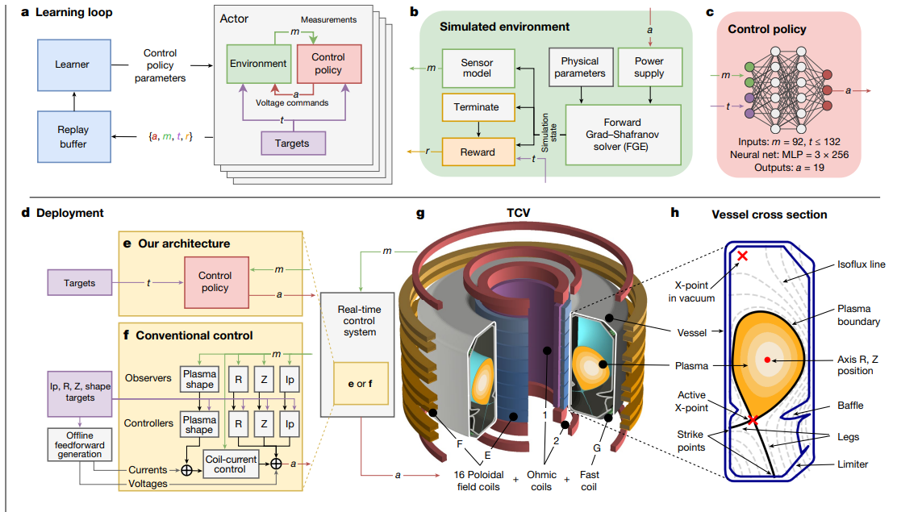
(Some) (Deep) RL Milestones
L. Brigato

